Slide 1
Linear Time Series Models

Slide 2
Linear Models…
Models used for short term forecasting
Moving Averages
Exponential Smoothening
Seasonal Model
Models for long term forecasting
Autoregressive model (AR)
Autoregressive and moving average (ARMA / ARIMA)
Regression Models with time
In time series methods like moving average works well if the series is stationary i.e. there is a mean reverting tendency.
So the dependence structure between the values of the series is very important , which can estimated through “auto-correlation”.

Slide 3
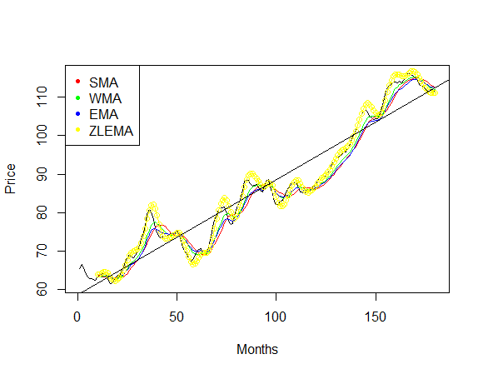
Linear Models …..
Hence , for a series to be stationary be mean should be constant and should not depend on time and auto-covaraince function depends only the lag (time between two events.)
For non-stationary time series , it is important to examine the relationship among the values of the series through Auto-correlation.
Following diagram is an example of a non-stationary diagram. Simplest form of non-stationarity is the ‘ Trend Stationary’. X(t) = m(t) + y(t), y(t) is a stationary process and m(t) is the trend.

Slide 4



Auto-correlation and Auto-covariance
Auto-covariance of a stationary time series can be written as follows
And the same for auto-correlation can be written as follows –
Auto-correlation can be tested using the following statistic –

Slide 5
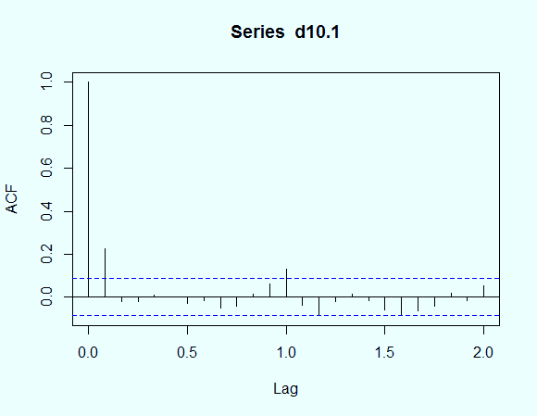
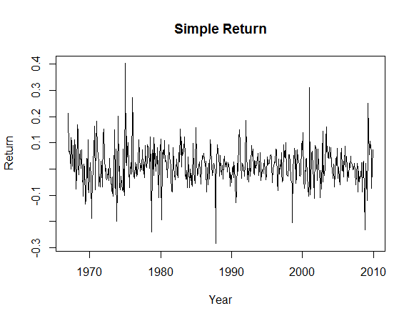
Visualization and testing of auto-correlation
the datatset contains returns simple monthly return of a portfolio from 1967 to 2009. creating a time series object for dec10 data –

Slide 6


Portmanteau Test – auto-correlation
Box – Pierce proposed Portmanteau test , where in the null hypothesis is
And the alternative hypothesis is following
Following test statistics is used for the test -
Q (m) is asymptotically a chi-squared random variable with m – degrees of freedom. So, if Q(m) is greater than the critical value of chi-square distribution then the Null hypothesis is rejected..

Slide 7
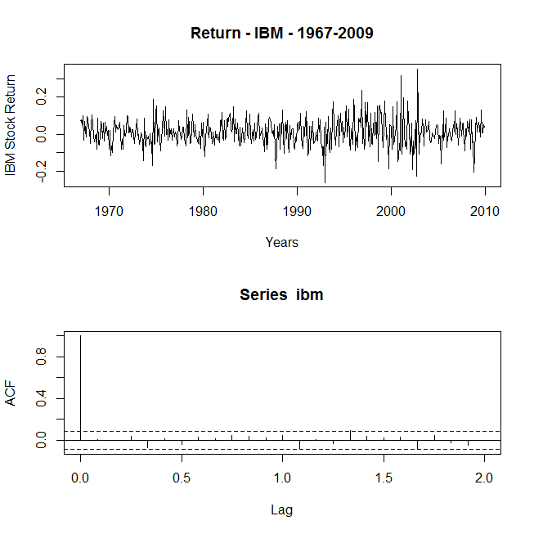

Slide 8
Portmanteau Test – auto-correlation
> Box.test(ibm,lag = 12, type = "Ljung-Box") Box-Ljung test data: ibm X-squared = 7.5666, df = 12, p-value = 0.818
> Box.test(lnibm, lag = 12, type = "Ljung-Box") Box-Ljung test data: lnibm X-squared = 7.4042, df = 12, p-value = 0.8298
* with p-value in excess of 0.8 , the null-hypothesis CAN NOT be REJECTED.
Studies have shows that the choice of m affect the performance of the test statistic , Q(m). To enhance the power of the test , m = ln(t).
But for time series with seasonality / cycles, generally cycles are considered.

Slide 9


Linear Time Series…..
A time series is said to be linear if it can be written as –
where µ is mean of X(i) and a(t) is sequence of iid random variables with mean 0 and a well defined distribution. The Box-Ljung test is one of the popular test for Whiteness , below is the test statistic and it follows chi-square distribution with l-degrees of freedom -
A time series is linear if it can be written as a linear combination of past innovation / shocks. For a linear time series the dynamic structure of x(t) is governed by the ( the weights scheme) i.e.Ψ

Slide 10


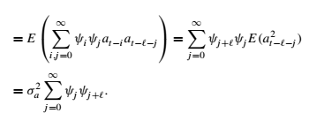
Linear Time Series…..
The correlation can be expressed as follows –
The lag-l auto-covariance of x(t) is –
For a weekly stationary time series , the weights tend to be “0” as the lag increases and consequently the correlation becomes “0”.
That’s past values do not have significant influence on the present value as the lag increases.
This takes us to the next topic of auto-regression.

Slide 11
Auto-regression
A simple model of auto-regression is as follows -
Wherein a(t) is assumed to be a white noise series with mean 0. the above equation is AR(1) as the lag is equal to 1.
In many cases , the immediate past value may not be able to explain the variation in the current value , in such scenarios data originating from long past . The following equation is the AR(p) model -

Slide 12

Properties of AR model
AR(1) model : If the time series is weakly stationary , then

Slide 13


Observations: AR(1) model
1. First the mean of x(t) exists if
2. Mean of the x(t) is 0 iff
3. Using the value of the mean , AR(1) can be expressed as follows –
4. Variance : [assumption : var(x(t)) = var(x(t-1))]
5. Auto-correlation:

Slide 14

AR model properties …..
AR(2) Model :
1. Mean -
Auto-covariance :
3. Auto-correlation :
The above equation can be rewritten as follows –
, where B is the backshift operator ,

Slide 15

Characteristics Roots……
The following equation is known as the characteristic equation –
Since it is a second order polynomial equation it will have 2 roots which can be expressed as follows
The Auto-correlation function is the x(t) is a mixture of two exponential decays.

Slide 16


Characteristics Equations ….
If φ1 + 4φ2 < 0, then the roots are complex and the plot of ACF of x(t) would show a picture of damping sine and cosine waves.
In business and economic applications, complex characteristic roots are important. They give rise to the behavior of business cycles. It is then common for economic time series models to have complex-valued characteristic roots.
For an AR(2) model with a pair of complex characteristic roots (a + b*i and a- b*i), the average length of the stochastic cycles is or
The second version of the average length of business cycle has been obtained by substituting the values of Φ1 and Φ2.

Slide 17
Characteristics Roots
In linear algebra , the there are important relations between the roots of the an equation and the coefficient of the equation.
A quadratic equation can be written as follows -
X^2 – (sum of roots)*X + (product of roots)*C = 0 , where C is constant.
Now , if a + b*i and a – b*i are the two complex roots of the characteristic equation (where i is the imaginary number).
Then , using the above relations it can be shown that Φ1 = 2a , Φ2 = (a^2 + b^2)^0.5

Slide 18
Stationarity
The stationarity condition of an AR(2) time series is that the absolute values of its two characteristic roots are less than 1, that is, its two characteristic roots are less than 1 in modulus.
Under such a condition, the recursive equation in ensures that the ACF of the model converges to 0 as the lag increases. This convergence property is a necessary condition for a stationary time series.
For AR(p) model if modulus of all the solutions are greater than 1 then x(t) is stationary.
The plot of ACF of a stationary AR(p) model would then show a mixture of damping sine and cosine patterns and exponential decays depending upon the nature of roots.

Slide 19
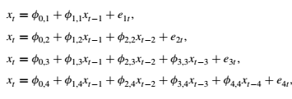
Partial Autocorrelation Function (PACF)
In time series it is important to estimate the order of Auto-regressive models and the method through which it is found is called order of determination.
There are two approaches for this , one is Partial Auto-correlation Function (PACF) and the second one is information criteria.
PACF can understood using the following AR models of various orders –
where φ(0,j), ,φ(i,j) , and e(jt) are, respectively, the constant term, the coefficient of x(t-i) , and the error term of an AR(j ) model

Slide 20
PACF Contd…
The estimate φ(1,1) of the first equation is called the lag-1 sample PACF of x(t). The estimate φ(2,2) of the second equation is the lag-2 sample PACF of x(t). The estimate φ(3,3) of the third equation is the lag-3 sample PACF of x(t), and so on.
Φ(2,2) shows that added contribution of x(t-2) to x(t) over AR(1) model. Similarly Φ (3,3) underlines the added contribution of x(t-3) over AR(2) model.
Therefore, for an AR(p) model , the Φ (p,p) should not be 0 and all Φ(j,j) should be close to 0 for all j>p. This property is used to determine the order of p.

Slide 21
Information Criteria
There are several information criteria available to determine the order of p of an AR process.
AIC ( Akaike Information Criteria)
BIC (Bayesian Information Criteria)
Information criteria measured the information lost while applying a model. This is also captured R-squared. R-square improves as more and more parameters are involved which increases the complexity of the model and the problem of over-fitting may arise.
AIC is defined as follows – -2/T* ln(likelihood) + 2/T * (no. of parameters)
For a guassian Ar(l) model AIC becomes – ln (σ^2(l)) + 2 l/ T, where σ^2(l) is the maximum likelihood estimate of variance of a(t) and T is the sample size.
the first term is known as “goodness of fit” and the second term is known as “penalty function”.

Slide 22
Information Criteria….
BIC(l) = ln (σ^2 (l)) + l* ln(T)/T , the difference between the AIC and the BIC is the penalty function. The penalty for AIC for each parameter is 2 and that for BIC is ln(T) .
Therefore, BIC selects lower AR model when the sample is moderate or large.
Selection Rule: To use AIC to select an AR model in practice, one computes AIC() for = 0, ... , P, where P is a prespecified positive integer and selects the order k that has the minimum AIC value. The same rule applies to BIC.
Model Checking – The behaviour of error of a fitted model should be carefully examined whether it is following white noise series or not. The ACF and Ljung-Box statistics of the residual should behave similarly as a white noise series.

Slide 23
Non-stationarity
So far our discussion has been restricted to stationarity. The most of common form of non-stationarity movement is Random walk , where X(t) = X(t-1) + a(t),
In recursive form it can be shown that the series finally depends upon the behavior of the a(t) part. If a(t) follows a normal distribution with 0 mean and 1 standard deviation , then it becomes “White Noise”.
In the previous section we have stated that the stationarity condition for AR(1) model is that coefficient of x(t-1) has to be less than 1 , but in this case the coefficient is 1. This shows that random walk can not be stationary.
Now, the random walk can be little bit tweaked if the above equation is expressed as follows x(t) = µ + x(t-1) + a(t).
The first component add a trend i.e. direction as time changes. Now the trend component can be removed by regression and then examining the residuals in terms of its distribution and serial correlation etc.

Slide 24
Unit Root test
To check the stationarity of a time series, the properties of auto-regression coefficient of lag(1) plays a vital role.
This involves testing whether the value of the auto-regression coefficient is equal than 1 or not. For a AR(1) model, x(t) = Φ(0) + Φ(1)* x(t-1) + e(t) So , Ho : Φ(1) = 1 and H1: Φ(1) < 0 – “t” ratio is used here where the test statistic is as follows -
DF = (Φ(1) – 1) / SE(Φ(1)) (Dicky Fuller Test)

